Slide 1
Finite State Machine and the SeatPM User Interface
Documentation for Senior Design
By Austin Pischer

Slide 2
Finite State Machine – Basic Concept
What is a finite state machine?
A (finite) collection of “states” that the program can be in
A collection of possible “events” that cause different things to happen depending on the states
A collection of “transitions” between states that depend on certain criteria being met
Why would we want to use a finite state machine?
It allows us to simplify the code. Rather than using many nested if/else statements, we can break down the system into many discrete chunks (states)

Slide 3
Finite State Machine – Basic Concept Example
Active Apps Button Pressed
Transition
Home Button Pressed
Home Screen
App Drawer
Active Apps Buttone Pressed
Transition
Home Button Pressed

Slide 4
Finite State Machine – Basic Concept Example
Event with Signal 1
Transition
Event with Signal 0
State 0
State 1
Event with Signal 1
Transition
Event with Signal 0

Slide 5
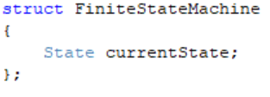
What is a Finite State Machine in SeatPM code? (Object Oriented C)
A finite state machine is an “object” containing a state
Normally an object would normally be an instance of a class
A class is just a user-defined data type
Just like how “int i;” declares instance “i” to be of type “int”,
“FiniteStateMachine UI_FSM;” declares instance “UI_FSM” to be of type “FiniteStateMachine”
Classes consist of:
1. Data (such as variables or pointers to objects)
2. Functions
Since C does not have classes, we have to bend the rules:
(This style of C is called “Object Oriented C”)
Class Data is contained in structs
Class Functions are coded to require a pointer to a struct instance to be passed in

Slide 6
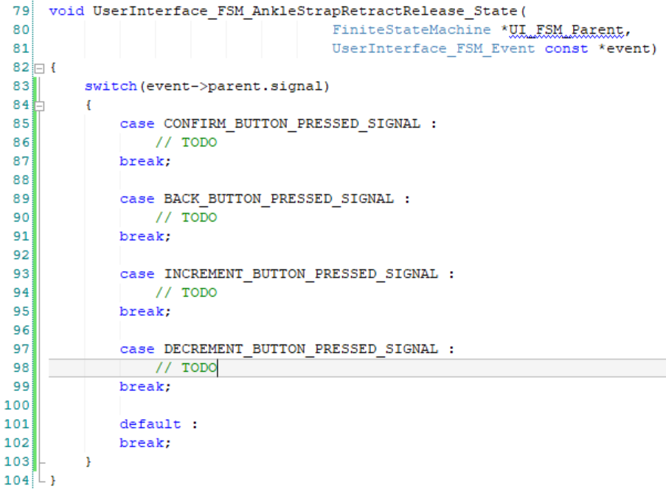
What is a State in SeatPM code?
A state is a function
It defines what happens in response to each possible event
As such, parameters for every state are:
1. A pointer to its associated finite state machine (to access the current state)
2. An event (see next slide)
Body of function looks like a switch statement, where each case handles one of the possible events

Slide 7
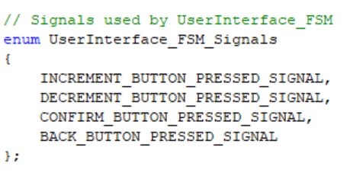
What is an Event (and Signal) in SeatPM code?
An Event is a way to pass data into a state function
An event must contain at least a Signal
A Signal is merely an integer to be checked in the switch statement of a state function
Why have a signal?
We need to perform actions within the state, and we need those actions to be different based on the unique set of possible inputs
The set of all possible signals for an FSM must be enumerated (enum)
This allows us to give names to each unique input without worrying about what integer values each input represents

Slide 8
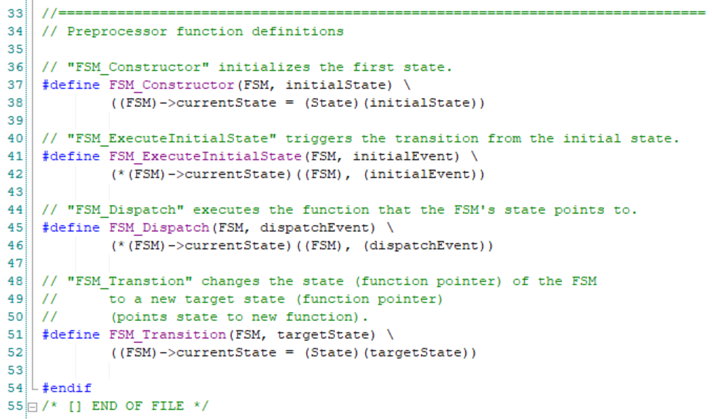
How do we implement the SeatPM user interface as a finite state machine?
The Finite State Machine class is a Base Class
Base class doesn’t actually implement any associated state functions, signals, etc.
Base class provides functions that all finite state machine implementations use (macro functions in our case)
Macros functions are #define statements used to replace function pointers with function implementations while compiling
Constructor,
Execute initial state
Dispatch (execute current state with event)
Transition (set new state)
More on next slide

Slide 9
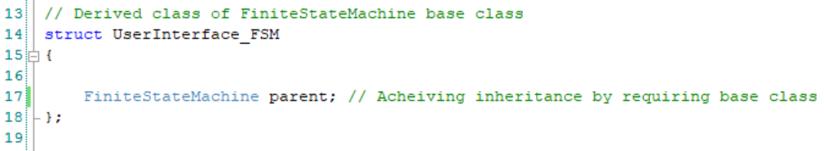
How do we implement the SeatPM user interface as a finite state machine? Continued
The User Interface FSM class is a Derived Class
It requires a Finite State Machine object as one of its data members
To review, this object is used to access the current state of the FSM and to access its base class functions
It requires a separate enumeration of all possible signals (4 in total, one for each button)
It implements each state independently of the base class

Slide 10
Summary Slide of things we have seen so far
Base Class:
FiniteStateMachine
-------------------------------
===Data===
+ Function Pointer to Current State
------------------------------
===Functions===
+ Constructor
+ExecuteInitialState
+Dispatch
+Transition
Derived Class:
UserInterface_FSM
-------------------------------
===Data===
+ Parent FSM
------------------------------
===Functions===
+ Constructor
+State 0
+State 1
+State …
+State n
Enum:
UserInterface_FSM_Signals
INCREMENT_BUTTON_PRESSED_SIGNAL,
DECREMENT_BUTTON_PRESSED_SIGNAL,
CONFIRM_BUTTON_PRESSED_SIGNAL,
BACK_BUTTON_PRESSED_SIGNAL
Normal use:
Construct UI_FSM
Execute Initial State
Button interrupts dispatch appropriate signal
States transition to other states
Base Class:
Event
------------------------
===Data===
+Signal
Derived Class:
UserInterface_FSM_Event
------------------------
===Data===
+Parent Event

